Slide 1

Understanding career aspirations of gen-z
INSIGHT
PRESENTATION
By Keerthana Nyalapally

Slide 2
Agenda
Introduction
Problem Statement
Project Flow
Employer Overview
Insights
Conclusion

Slide 3

Introduction
This project explores the career aspirations of Gen Z, focusing on what today’s young workforce values in their professional journey. Through data-driven insights, the study examines their preferred work environments, learning expectations, growth motivations, and the evolving factors that shape their career decisions. The findings help organizations understand how to engage, support, and retain Gen Z talent more effectively

Slide 4
THE PROBLEM STATEMENT
Understanding Career Aspirations of Gen-Z
For this problem statement, we are going to understand about the Career Aspirations of Generation-Z who are going to be the 32% of the total workforce by 2026, their contributions will be huge in the prospect of our countries and world economic growth.
This analytical learning is focused towards understanding the gap which might help the recruiters address and at the same time to have right people on board.
Few articles for a small minutia:
https://www.workdesign.com/2022/08/authentically-gen-z-the-values-aspirations-drivers-that-will-re-define-the-future-of-work/
https://hbr.org/2023/01/helping-gen-z-employees-find-their-place-at-work

Slide 5









PROJECT FLOW
Data Collection
Problem Statement
Creating Business Research Document
Different methods used to collect Data
Understanding the key problem which need to be addressed
Knowing who all are involved in i.e, Key stakeholders
Insight Generation/ Findings
Data Visualization
Data Analysis using SQL
Seek Business findings
Build effect dashboards to visualize it
Addressing key business Questions

Slide 6
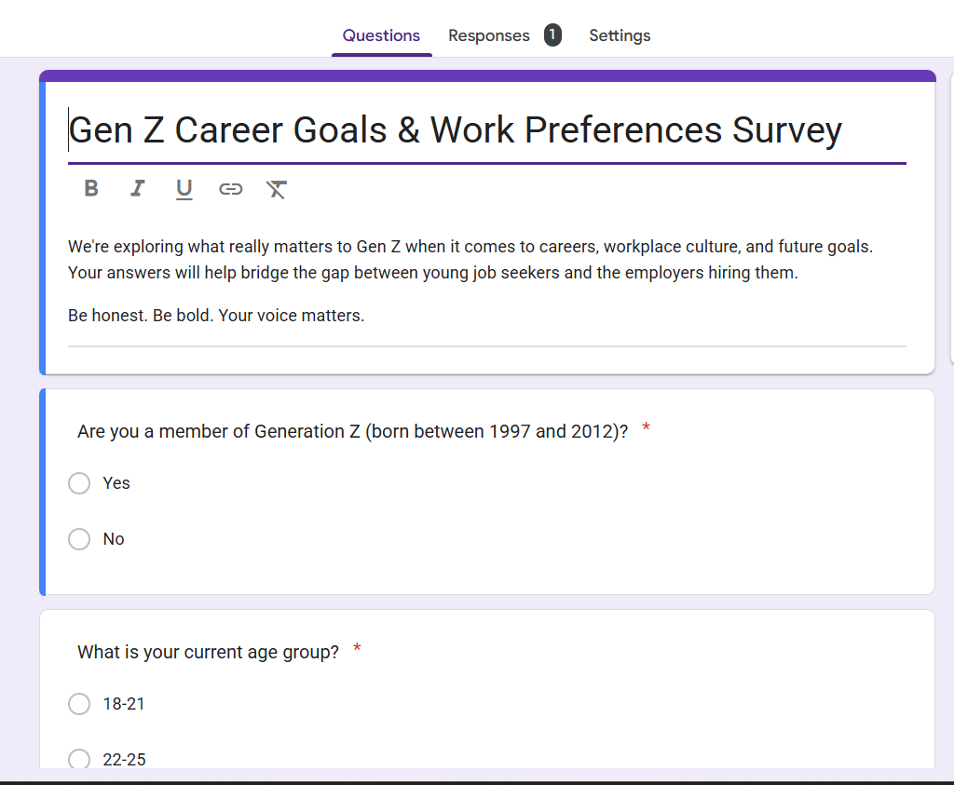
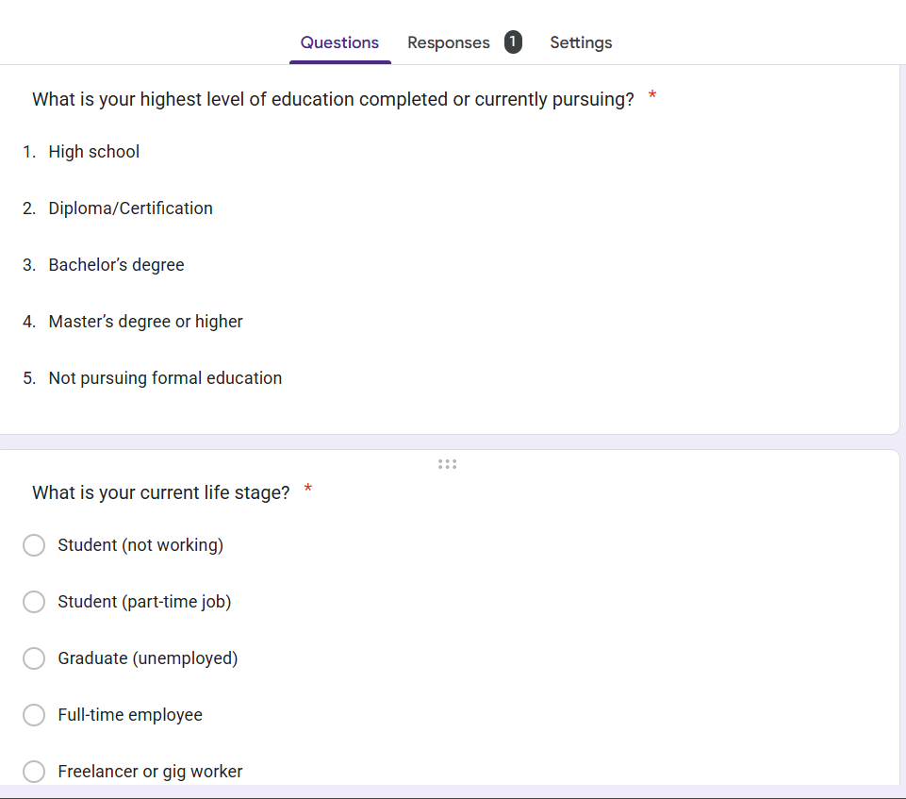
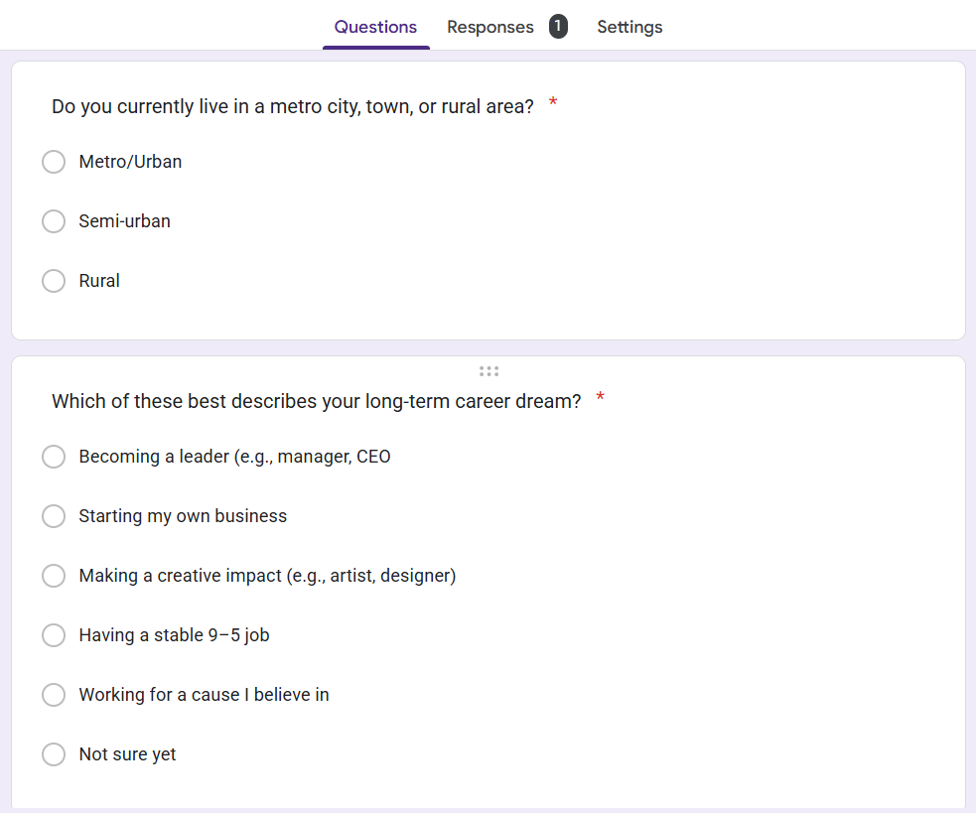
Data collection via Google forms
Data was gathered from the Gen-Zs through almost every social media platforms like LinkedIn, Facebook, WhatsApp, Gmail, Instagram etc.
We received around 3400+ complete forms and about 50000 responses. The responses were roughly from 1800 different Postal codes across India.

Slide 7
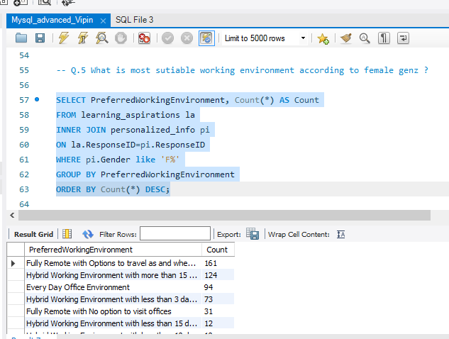
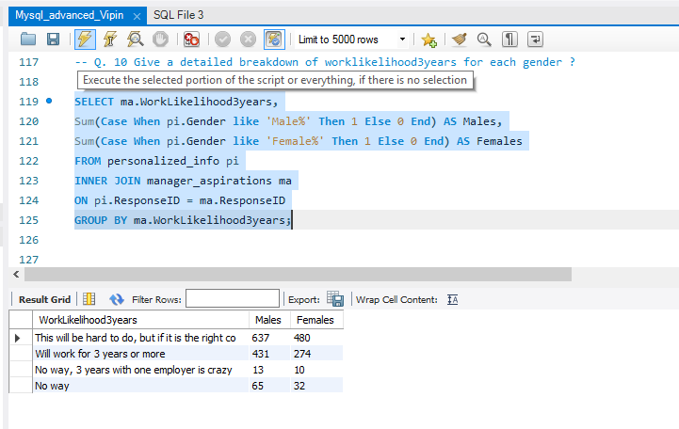
DATA ANALYSIS USING SQL QUERIES
For analysis I have used MYSQL.
Collected data has imported from csv and xlsx files to the My sql server.
Wrote SQL queries to understand the business answers and also to get insights while solving various business questions too.

Slide 8
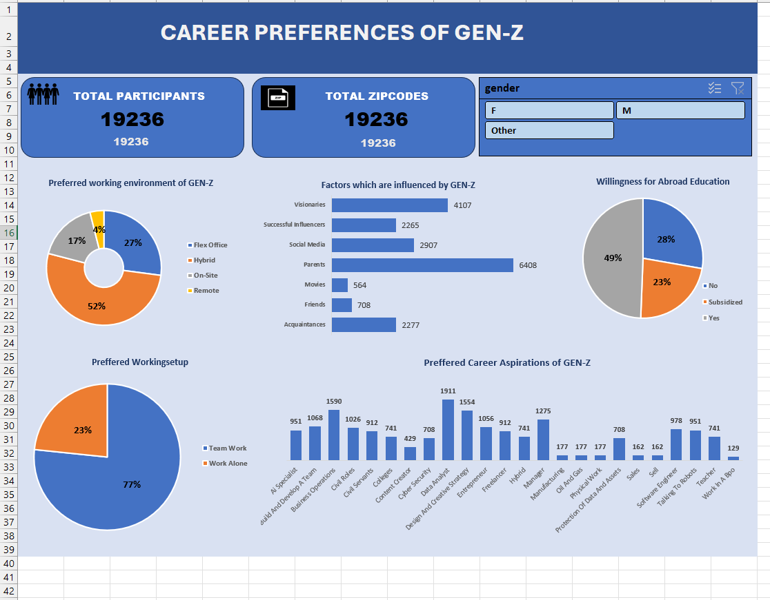
EXECUTIVE DASHBOARD IN EXCEL

Slide 9
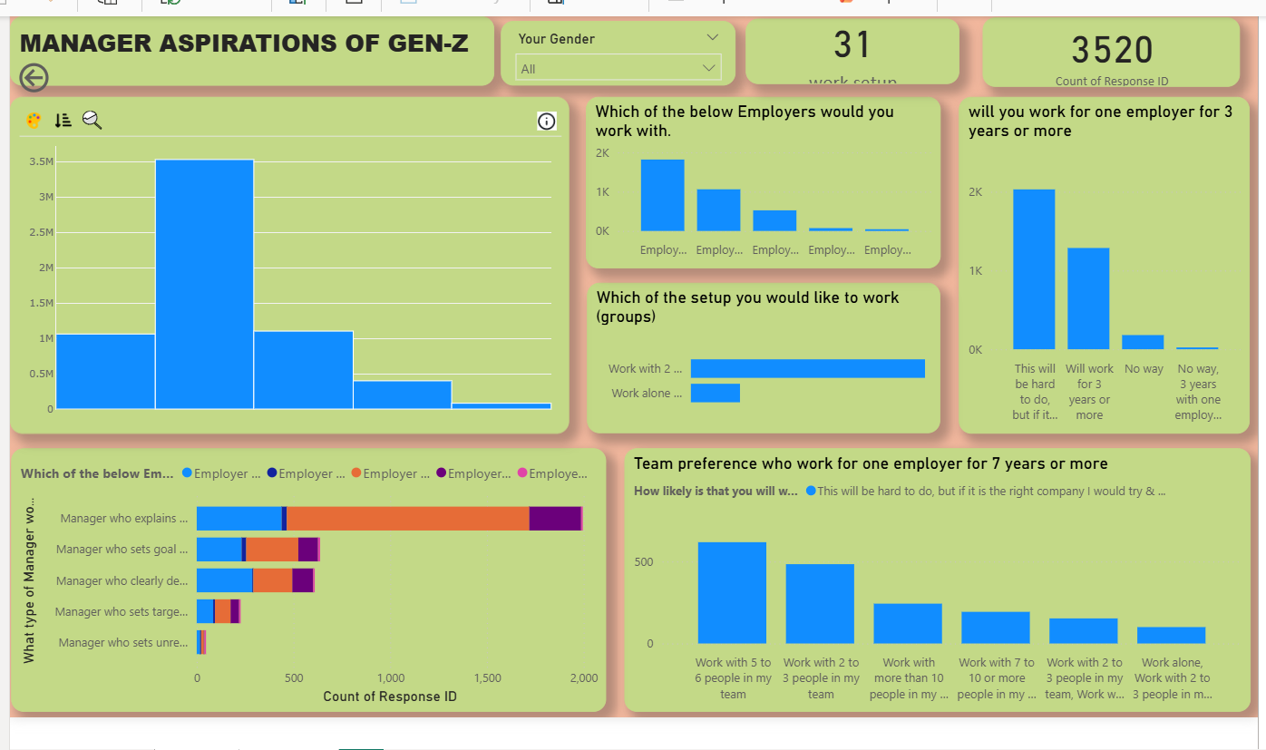
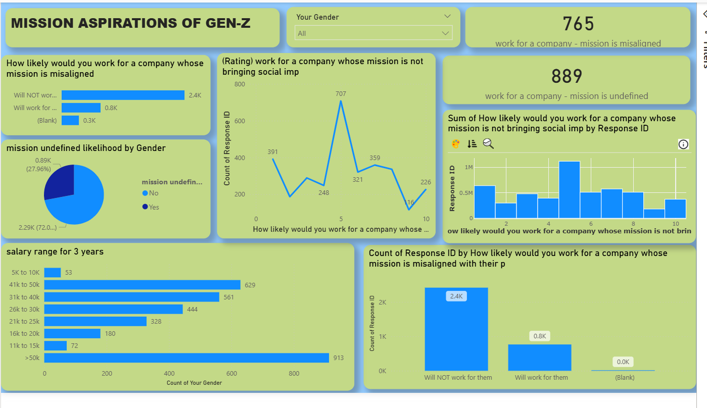
FUNCTIONAL DASHBOARD IN POWERBI
Created 2 dashboards in Power-Bi to have a deep visual understanding
Manager aspirations
Mission aspirations.

Slide 10

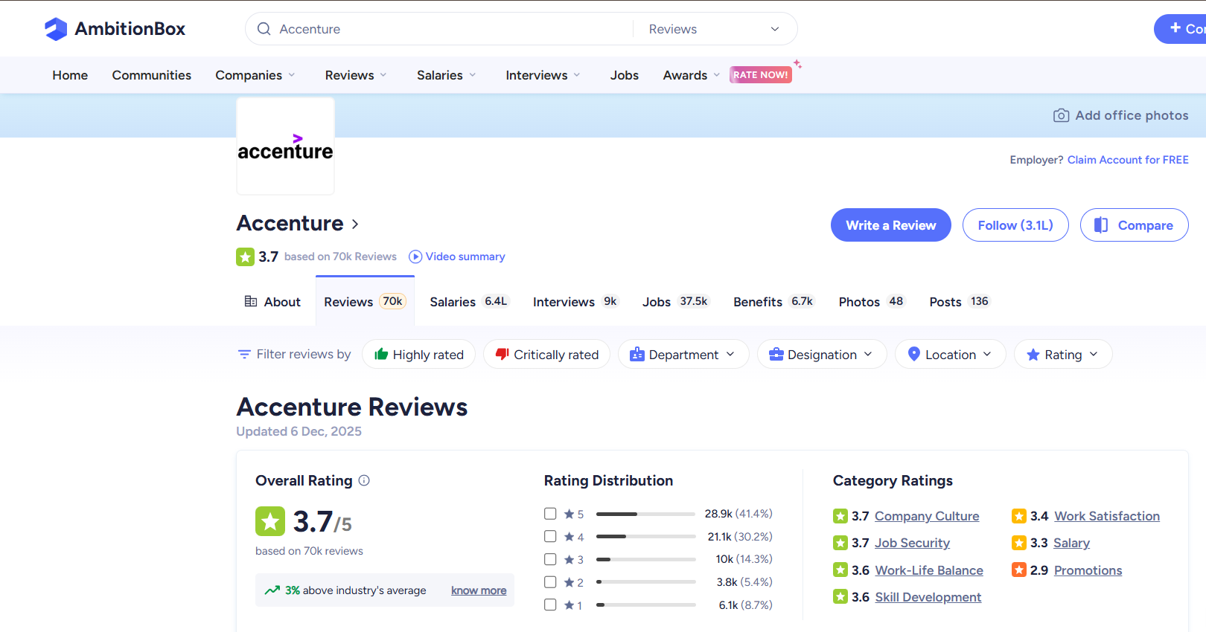
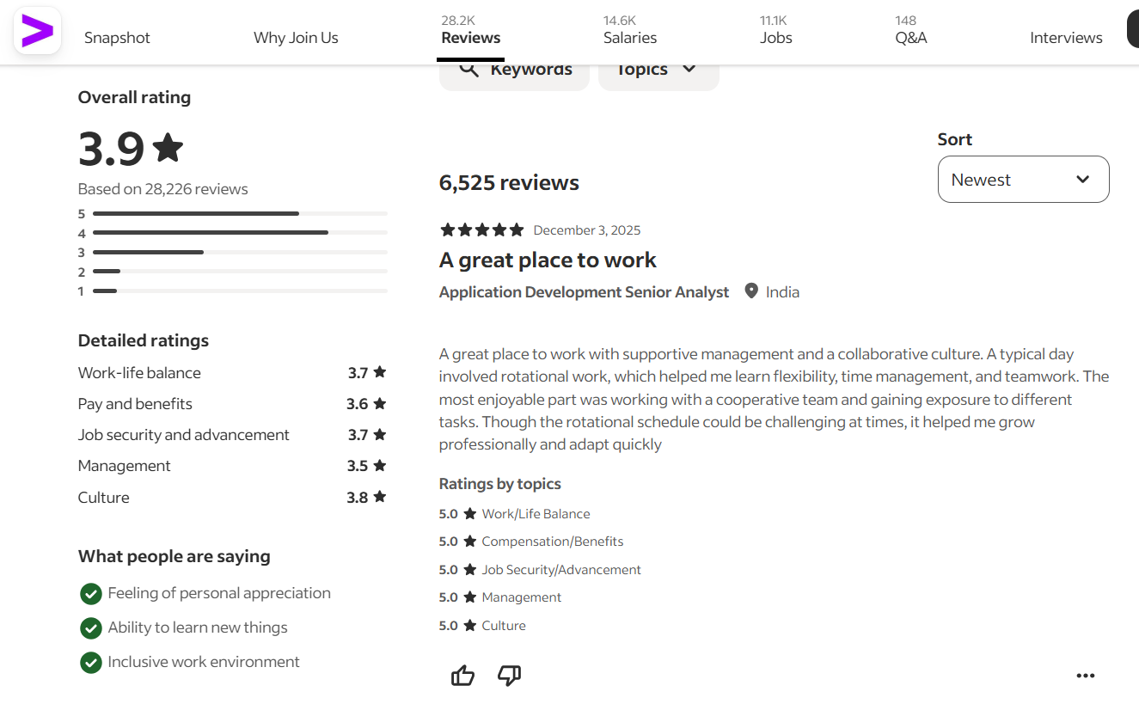
ACCENTURE REVIEW RATINGS(AMBITIONBOX AND INDEED)
Key Highlights
Overall rating: 3.7–3.9/5 — generally positive.
Strong in culture, job security, work-life balance, skill development.
Weak in salary and promotions.
Recommendations
For Accenture:
Improve salary benchmarking & transparency.
Make promotion pathways clearer and faster.
Strengthen manager training & workload management.
For Gen-Z Jobseekers:
Choose teams wisely; manager matters.
Use learning programs to accelerate growth.
Document achievements for faster progression.
Pros
Supportive work culture & stable environment.
Good training and learning opportunities.
Decent work-life balance for many roles.
Global exposure and diverse projects.
Cons
Salary below market expectations.
Slow/unclear promotion pathways.
Workload spikes in some teams.
Experiences vary widely based on manager/team.

Slide 11
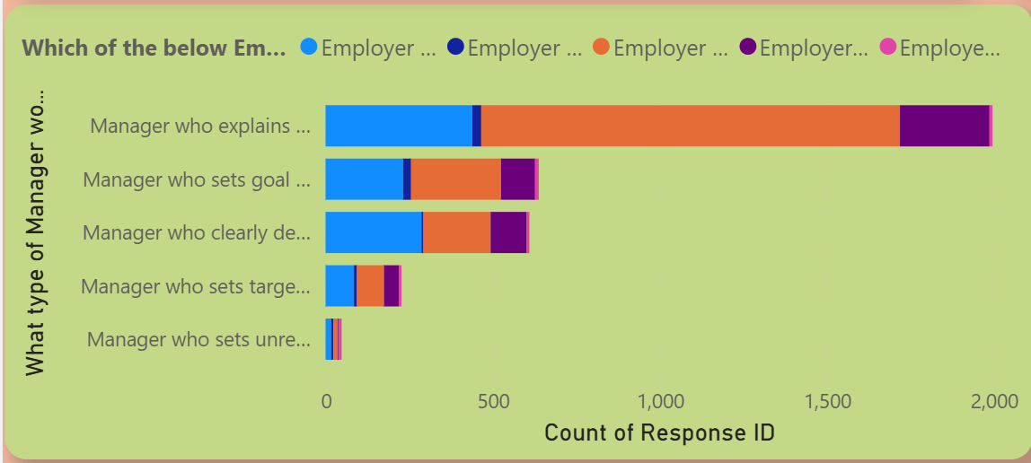
GRAPH 1 & Suggested Recommendations
Recommendations
57 % of employees have preferred to work under a manager who explains what is expected and who guides them in achieving those goals.
Least preferred managers are those who set unrealistic goals and doesn’t help them address those issues.
Set Realistic expectations & provide clear communications.
Having an effective Mentorship, training programs, and skill-building opportunities.
Workload assessment as well as leadership training.
Use employee surveys regularly for feedback.

Slide 12
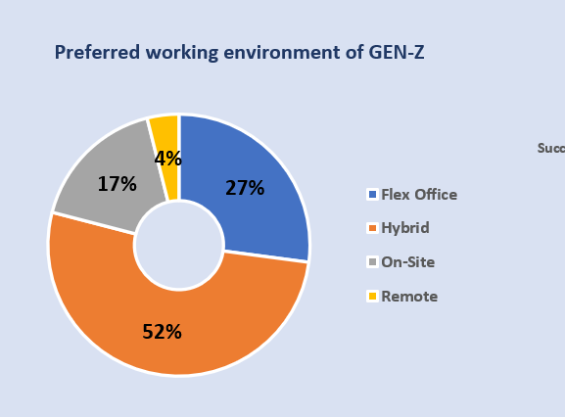
GRAPH 2 &SUGGESTED Recommendations
Recommendations
Hybrid work model dominates with 52% of GEN-Z preferring a flexible mix of office and remote work. 27% prefer flex office indicating that structured in-office work is still valued when it allows autonomy.
Everyday office culture are only to limited percent.
Enrich Flexible work arrangements.
Promote Time off and encourage breaks to avoid burnouts.
Need for cutting-edge tools, digital communication, and tech-savy environments are highly preferable.

Slide 13
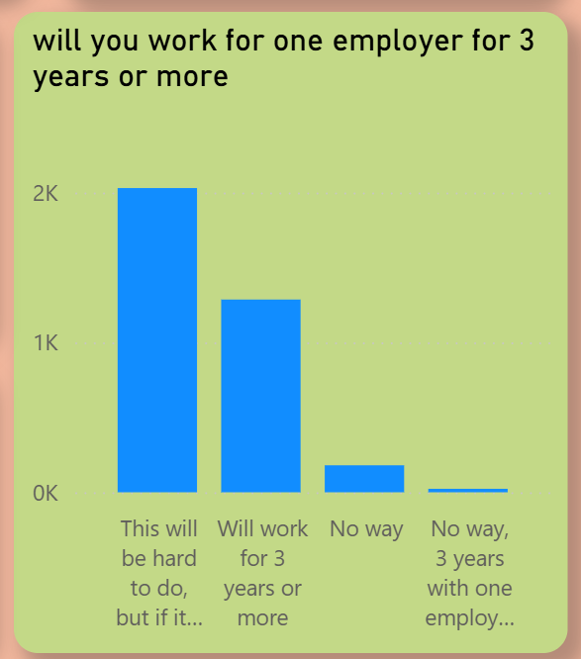
GRAPH 3 & SUGGESTED RECOMMENDATIONS
Recommendations
Emphasize the value of collaboration and teamwork thereby building a ecosystem of trust and inclusive work culture.
Explore the desire to for healthy work life balance & Discuss strategies for promoting well-being and mental health in the workplace as well.
Implement Wellness program as well as regular training and development & Employee assistance program(EAP).
Delegating Responsibilities would yet be another thing which can be considered during workload.

Slide 14
CONCLUSION
Gen-Z prioritizes flexibility — remote/hybrid work models and supportive work–life balance remain their top expectations from employers.
Career growth and continuous learning are major decision drivers; Gen-Z prefers companies that offer upskilling, mentorship, and fast career progression.
Work culture matters more than salary alone — inclusive teams, transparent communication, and mental-health friendly environments strongly influence job choices.
Tech-savvy workplaces attract Gen-Z, especially those using modern tools, digital workflows, and innovation-driven projects.
Data analysis shows a clear preference for companies with strong employer branding, positive reviews, and stability (e.g., companies like Accenture, Deloitte, TCS).
Compensation and promotion clarity remain pain points; Gen-Z expects fair pay, predictable evaluation cycles, and transparent growth pathways.
Gen-Z seeks purpose-driven work — roles that allow impact, creativity, and alignment with personal values.

Slide 15


